Slide 1
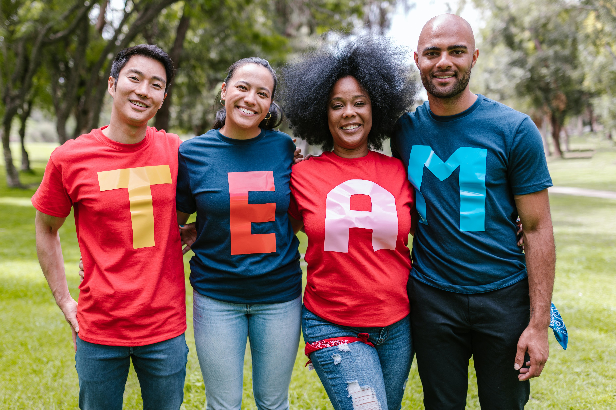
Personal Development & Team Leadership
Prof: Andrew PRIOR
Class 5: -Mon-4-Nov-2024
Notes:
Self Expression – full potential

Slide 2
Where are we in the course?
About six weeks
About four weeks
Team Leadership: building your team skills
About four weeks
Personal Development 1:
understanding yourself now
Personal Development 2: Growth mindset and your future
Class 5
Understanding how you interact with individuals and groups
Using your new knowledge of you and team, set your goals

Slide 3
That’s what we did last week!
Learned how body posture “power poses” affects hormones in the body (Amy Cuddy research)
More about Personalities and MBTI
Type alike groups
Type dynamics, how our personality develops according to Carl Jung
Self organised into learning groups (forming) based on some principles related to diversity
Started creating a poster

Slide 4
Some Comments from Learning Logs
I'd feel more comfortable (worried?) if there were more 'introverted' activates that require less speaking in groups. Even if I understand that this course can help me to open up more and I must try to improve on this aspect
Good amount of group exercises. I liked to have an exercise where I could read, reflect and write something of my own before sharing.
I realize that vulnerability can strengthen connections and foster support within my group. I also aim to practice better emotional regulation by reflecting on my reactions before responding to challenging situations
Emotions can be very complex to understand. It was very interesting to watch the video where it became clear that a feeling can often occur due to something deeper, that have happened before. Or depending on what you think of yourself.
Emotions are based on our perceived reality, not on what happened.
How will we learn to be better leaders if only one of us gets to be the group leader?
What is the poster going to be useful for in this class ? Will there be questions on it?
Be aware of the brain jumps (think this is very difficult) but I guess the first step is to be aware of it and even know that it is a think we tend to do.
Maybe make it so that everyone can talk, because now there is a lot of mumbling.
more vids like the podcast on YouTube you showed.
I liked how the paper about being present went around the classroom, instead of a big line waiting to sign it!
Dealing with emotions are not easy, and at some point even annoying. Fleeing seems to always be the better answer but doesn't seem to be efficient in a long run
Would it be possible to have more breaks.
Go faster. I really did not learn a lot considering I spend 3h in class.
I’m not gonna lie, this lesson taught me absolutely nothing, I don’t know what was the point of this class specifically
Some of the material can be better taught if we have a more standard classroom lecture. Now I feel that we only talk in groups and sometimes it feels that the time could be better used. Maybe we can have a clearer separation between classroom teaching and group activities?
Please lets do something more energetic in the beginning, I have a really hard time waking up and talking with other people if I am sleepy.
I felt the class was a bit on a rush so we didnt have a lot of time to go deep into the main concepts

Slide 5
Some Questions from Learning Logs
What will this group project consist of?
How does the professor choose that some questions are more interesting than others in the learning logs ?
What are some effective strategies for managing emotions in everyday situations?
Is the "over-identification” (dwelling on them?) of feelings and emotions prevent us to understand each other smoothly ?
How is emotion understanding and identifying related to problem statements?
Are we going to talk about concrete actions that we can take to improve ourself ?I would like to have clues or idea of habits or actions that we can take to actually evolve on our own
I feel like the group thing is a little bit weird. I mean we are supposed to work in team but we don't have a clear project or objectives as a group. I understand that it is suppose to helps us grow individually thanks to the group energy but i don't know how we are supposed to do this if we don't have a common interest / goal.
What will be the tasks of the learning groups?
I think it was easier to know what we are doing this time but some things remains strange for me like why knowing that this upsetting moment gave me those emotions can be good for a team leader I think more explications can be good
Could we address the subject of first impressions ?
Can you be both a leader and a friend to your team members?
what you think you as a professor solution and measure should the france gouverment do against the plastic pollution
How can we make sure that our past experiences don't make us mind-jump, but that we still bring what we learned from them with us into new experiences.
What is the utility of the learning log ? Is it for us ? For you ? I have the feeling that I don't have so much to say in some boxes (exemple for the questions I would like answered)
Is understanding emotions really key to interacting with people? Is seeing a psychologist of professional helping?
How is the problem statement thing connected to the topics we talked about earlier. This change of topics seemed a bit random.
what is the best daily thing we can do to better managing and using our emotion?
What after identifying our emotions? What actions can you take?
Could MBTI be like a label that pushes me to unconsciously become more like the tested type or the type I liked?

Slide 6
Intention for today
Where are we on the course?
Review group tasks from last week
Learning Groups working towards a shared goal
Group v Team (team agreement with a team task, clear boundaries, authority, membership)
Team member competencies: Empathy and Integrity
Teambuilding exercise => Helium bar
Stakeholders? Who and What are they? (Learning Group and Rep Group activities)
Using personalities preferences in groups related to problem statement
to gather information IS, ES, IN, EN,
to make decisions IF, EF, IT, ET (article on system 1 and system 2 Kahneman)
Working towards effective groups: feedback
Learning Log
Notes:
13h30 Where are we, review group tasks & group names/emails
13h45 Quizz on Sinek video and mark quizz
14h10 MBTI update, any questions on MBTI so far?
14h15 Maslow
14h25 SBINR feedback model
14h35 Role play & practice
15h00 Break
15h15 Helium Bar
15h30 Debrief in team
15h45 Learning points – class participation – link to trust equation
15h55 Giving feedback in the team. Observer starts. Start with positive impact to anchor behaviours that want to sustain. Build social capital – intimacy
1 person gives 2-3 feedbacks (5’ prep + 5 minute f/b per person = 35)
16h30 Reflection on giving feeback (benefits – how did it feel receiving it, giving it now you how it feels receiving it
16h35 Learning logs

Slide 7
So, assignments for next class:
Personal tasks
Watch the videos:
Dr. Gabor Maté on How to Reframe a Challenging Moment and Feel Empowered https://www.youtube.com/watch?v=__JLFw2FtEQ
The power of introverts https://www.ted.com/talks/susan_cain_the_power_of_introverts
Reflect on a problem you are interested in => create a problem statement
Team tasks. Organize a team meeting together to
Select some-one to represent the Group. This is a Group role that will have additional responsibilities
How did your Learning Group decide on a representative/leader? What was the group process (gathering info, making a decision)
Create a Google Drive for your Group and a Google Doc that has General access so that anyone can view with a link.
Create your Group’s coat of arms and save it in the Google Doc. Also save other information e.g. the poster of your team, your shared objectives and strengths, your Group problem statements…
Each learning group representative will contact me before Thursday 24th Oct 12h00 and send me the link to your Google Doc (so I can put it on Moodle)

Slide 8
Learning Group 1-4
Group # | Learning Group Name | Members names | Group culture, level of Diversity, Mother tongue, culture, MBTI, gender
1 | Diplomatic-Detour | Sarra Gharsallah Noam Benazouz Mohamed-Khalil Kiri Mohamed-Dhia Mediouni Xiyao Zhou Ayman Fatich Josef Korkosh
2 | Some-what-diverse | Brice Robert Amandine Dilvy Mathieu Henry Nathan Matelat Anders Furdal Wold Aleš Zapadlo Cannelle PEIXOTO Oda Kristin Gripenberg
3 | 7th Spirit | Emma Jolivet Mohamed anis Belhadef Emna Bouguerra Sanda Dhouib Mohamed Douiri Manon Galtier Sofiane Karaouni
4 | Team-Diversity | Rim FAROUDY Ugo CECCONI Álvaro DE CASTRO Lucas DELHOMMEAU Kristian HÅLAND Vojtěch HAŠPL Alireza MOTAMEDIAN, Inka VIITA

Slide 9
Learning Group 5-8
Group # | Learning Group Name | Members names | Group culture, level of Diversity, Mother tongue, culture, MBTI, gender
5 | Feel-Leading | Jeanne Goncalves Simon AUTECHAUD Alexandre Bonan Tuomas Rahkola Jiacheng Wang Xinyu Yang Yoann Eusebi Souha LABIDI
6 | Team6 | Herman Østengen Efaz AHAMAN ULLAH Alex Argese Aurelien Brun Ana Martinez Gonzalez Njål Svensen Jonas Thalmeier
7 | World-Finest | Louise Labbé GHOFRANE BAROUNI Annie Claesson Shyni HETTIARACHCHI Tarek Saade Lilian VARINOT Juan David Zapata Cruz
8 | Organised-Team | Sander Bakke Mohamed Amine Khediri Zhen Ma Mohamed Ali Msadek Clement RICHARD Aida Teshome Teressa Linda Aström

Slide 10
Learning Groups Create Google Shared Drive/Doc. Moodle Link
Who are the members in your learning group?
Poster gathering information showing diversity of culture, personalities, and dominant/auxiliary cognitive functions (Se, Si, Ne, Ni, Ti, Te, Fe, Fi)
BIG 5 https://www.personalitytest.net/ipip/index.html
What was the decision-making process for selecting your group representative (or group leader)?
What is your group’s coat of arms, what is your group identity? What does these symbols mean to you?
What is your group’s current problem statement?

Slide 11
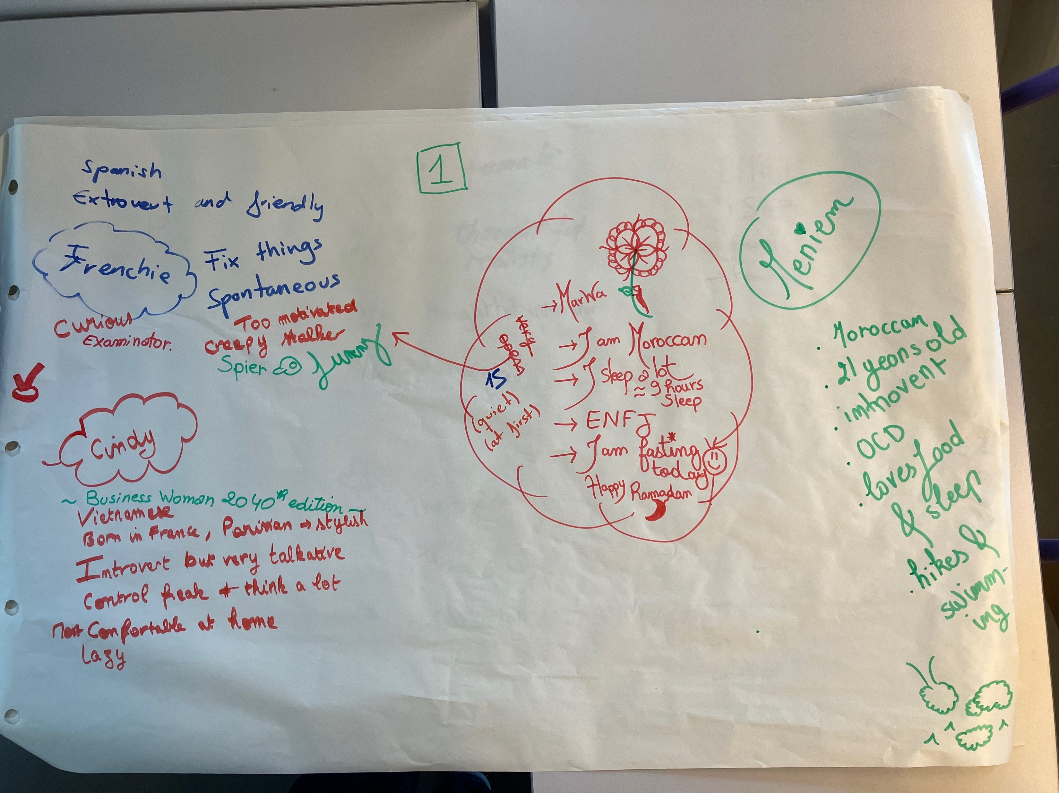
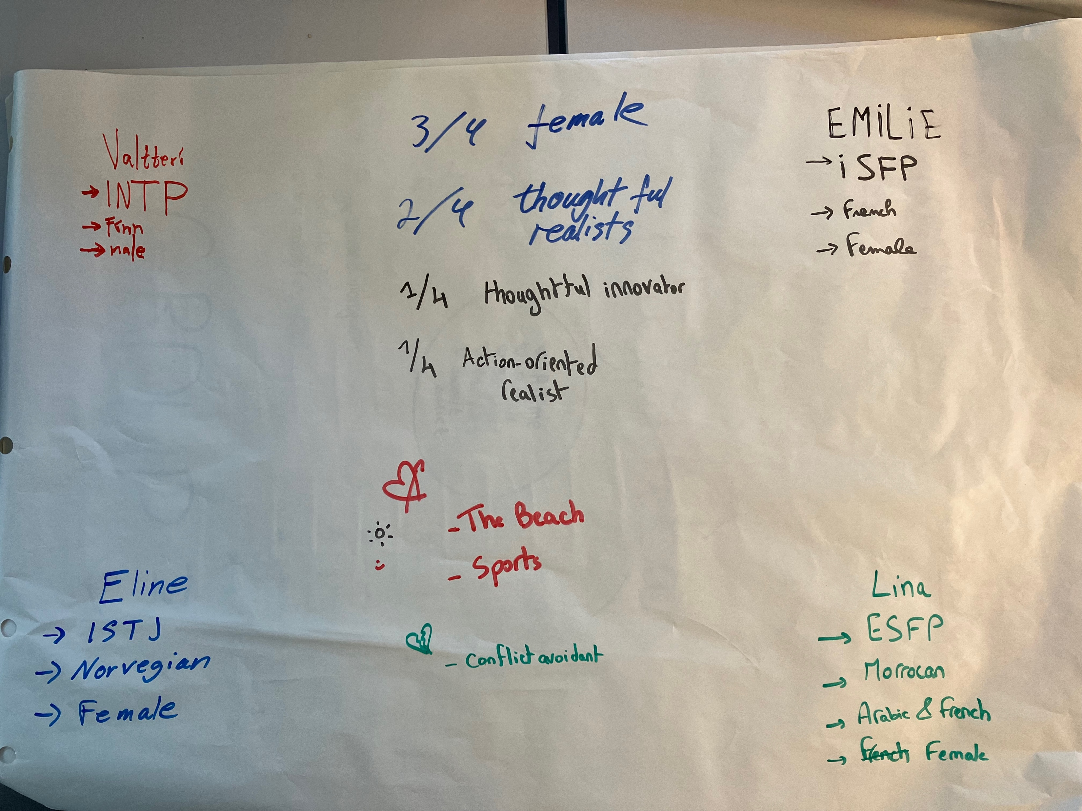
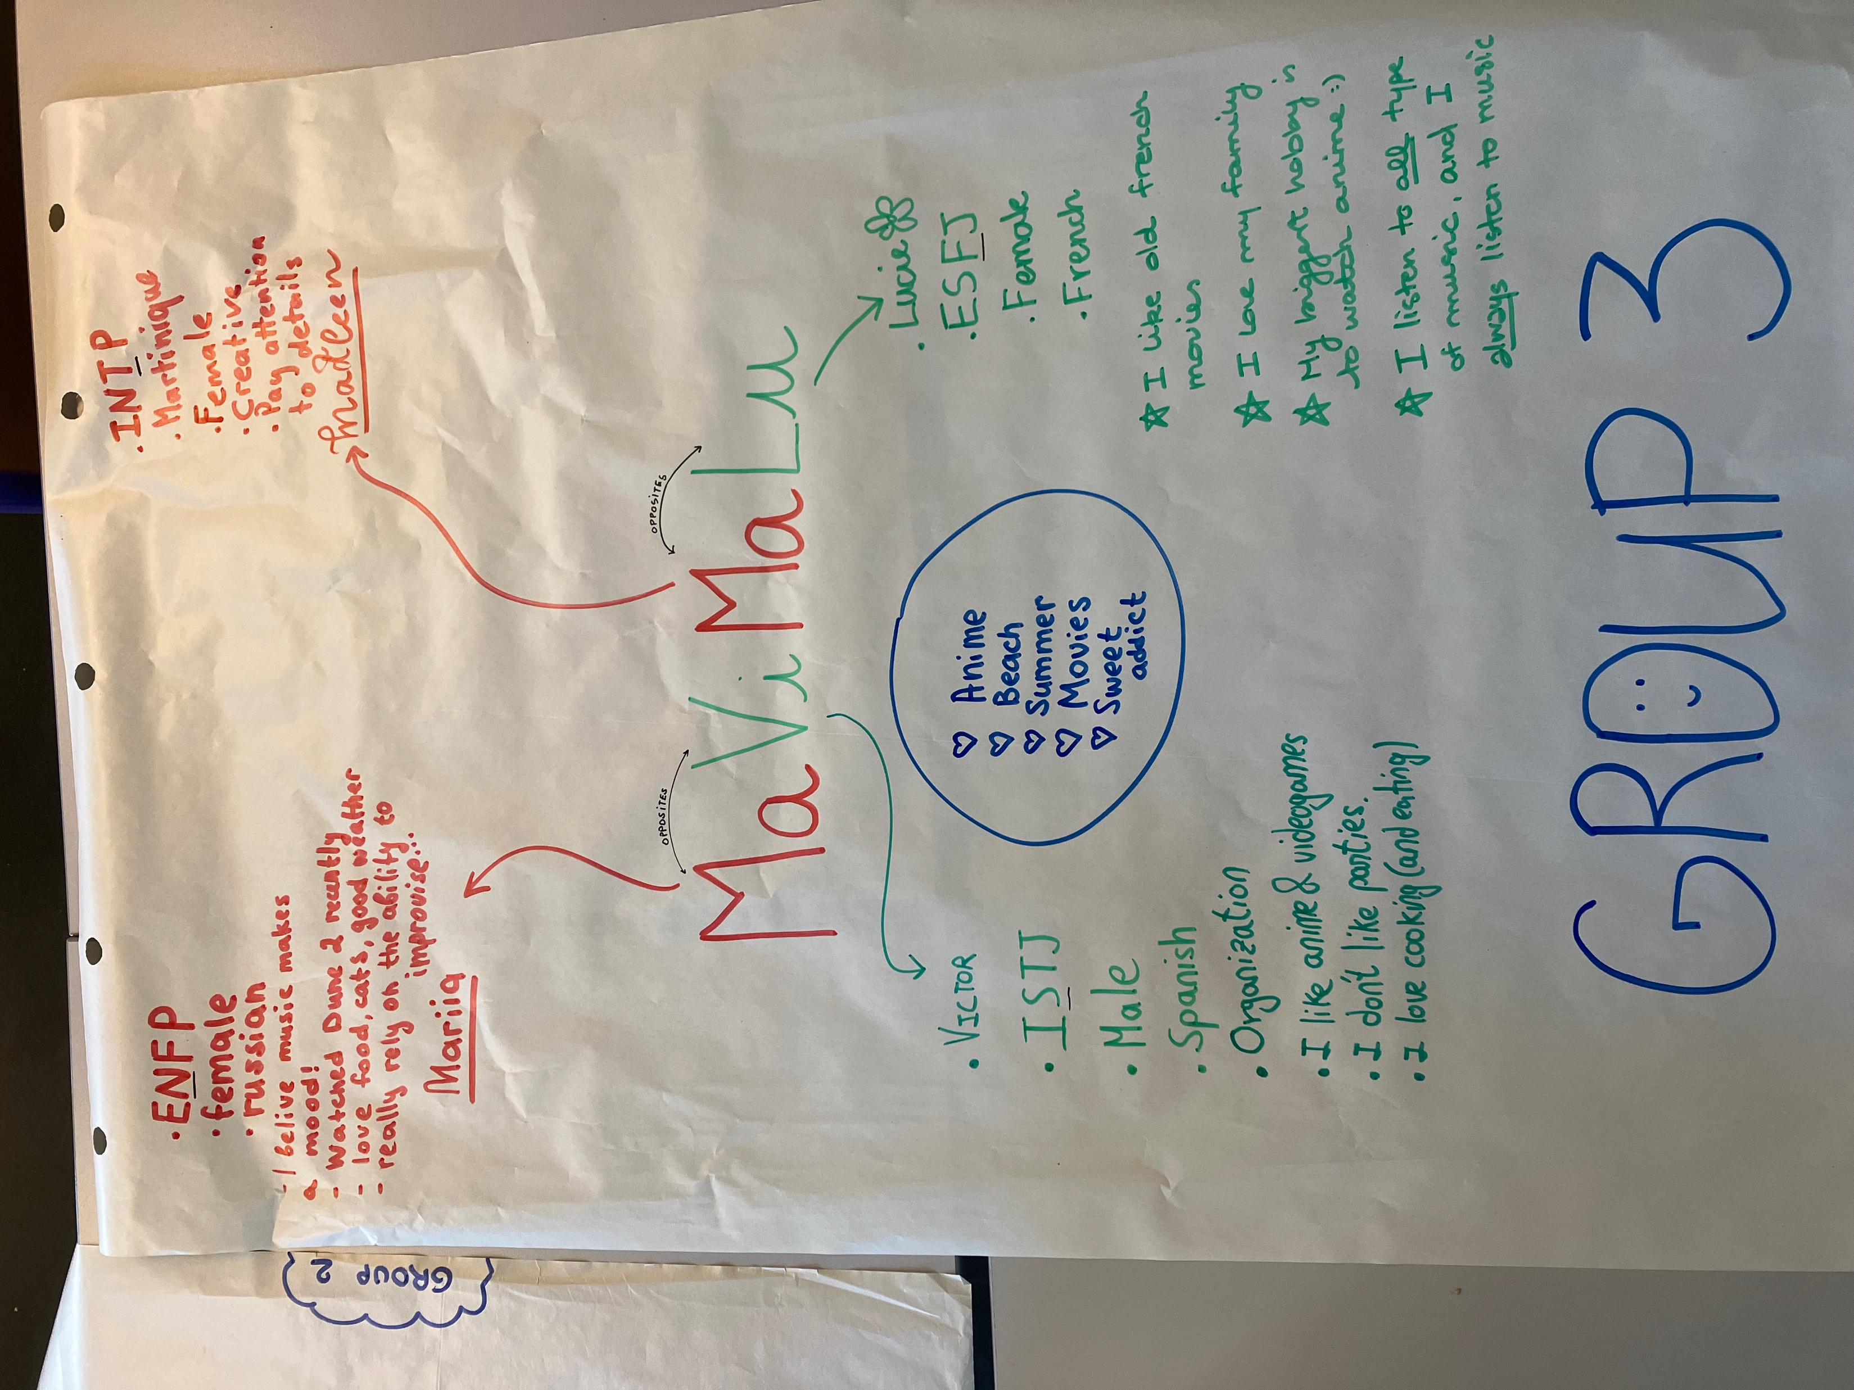
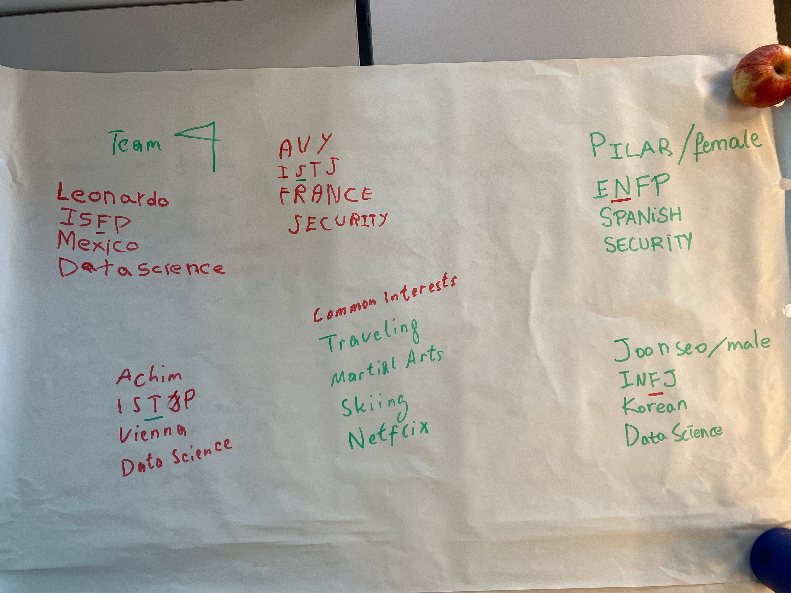
Group details

Slide 12
A Shared Problem Statement:
The task is to reach, among all the participants of the group, a SINGLE consensus on the problem statement.
In the previous exercise, each of you created your own one-sentence problem statement. You will now share this with the group
You must all come to a consensus on how to describe the problem in a single sentence.
From all the definitions provided within your group, choose only one; the one that, based on the contents and the theory studied, adequately represents or defines the problem posed.

Slide 13
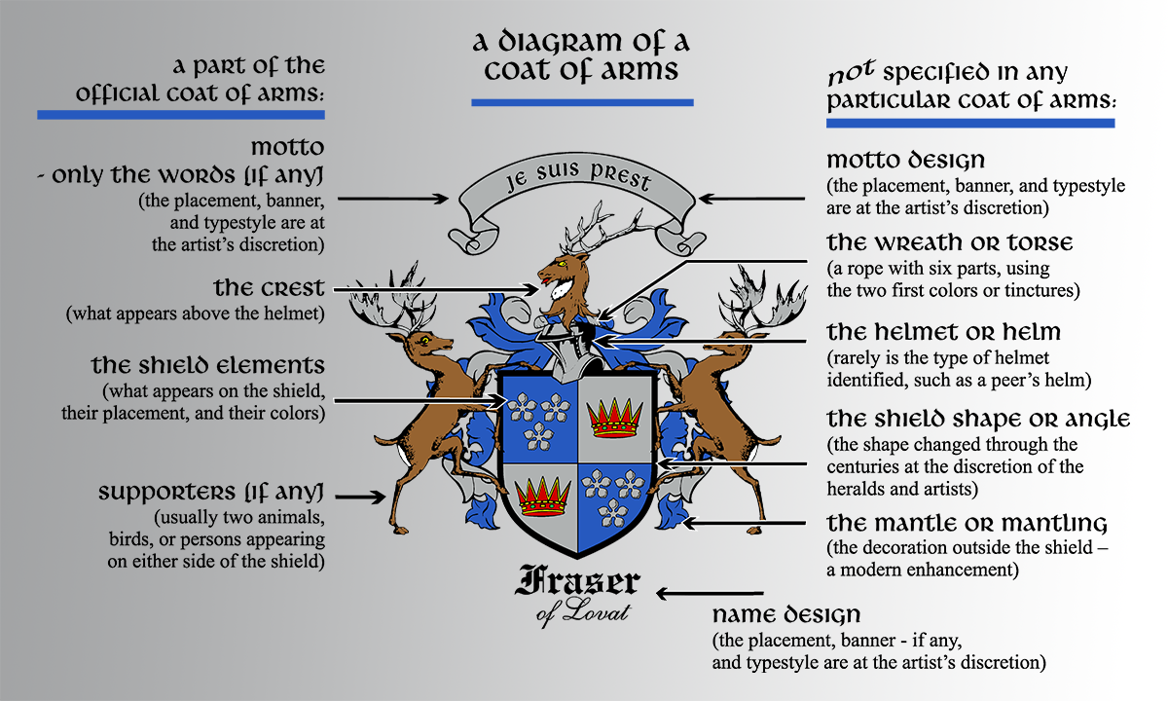
Group Task
Each group create a ‘coat of arms’ for the group, which expresses – visually – the highlights of your group’s qualities and strengths (perhaps refer to the group name)

Slide 14
Making an experiment?
Problem: Low engagement in workplace. Read Gallup study in Moodle
Hypothesis: Working in functional groups and teams improves motivation, engagement learning and development in organisations
Reps or group leaders form a “meta learning” group
The reps/leaders group is accompanied by co-coaches (Andrew and Thibault) over 6 weeks, 1h30 hour per week between classes (learn about coaching)
The purpose of the representative group is to learn team leadership skills with the co-coaches, and share learnings with their learning groups

Slide 15
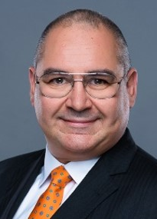
Thibaut Righenzi Team Co-coach
With over 15 years of experience in a range of operational positions, from Development Engineer to Department Manager, Thibaut has carved a niche in driving transformative change. Over the past 7 years, his expertise as a Change Management Consultant has been instrumental in guiding organizations toward nimble and adaptive operational models.
For the last decade, Thibaut has dedicated himself to fostering organizational agility, drawing on his certifications in executive, team, and organizational development coaching.
His approach is rooted in core principles that synthesize agility, change management, and coaching, focusing on cultivating a Shared Vision, fostering Collaboration, encouraging Co-construction, ensuring Continuous Value Production, striving for Continuous Improvement, and supporting Autonomy.
Outside the professional realm, Thibaut is a devoted father to three children, ranging from 10 to 22 years old. His passion for the arts is all-encompassing, and he boasts a rich history as a tenor, a talent he showcased for a decade prior to marriage.

Slide 16
Forming a learning group of representatives
Representatives come to front of the class
Introduce yourselves to the class
Why did the group chose you to be their representative?
When do we meet between class?
Tuesday between 12h-13h30h
Wednesday between 12h-13h30h
Virtual meeting MS teams / Zoom?

Slide 17
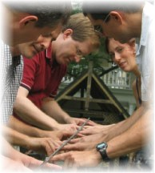
Team building Activity so that you get to know each other better
Helium Bar:
One observer from each team:
Rules, behaviors, tone, words (facts)
Group members on each side of the bar
Important rule (or constraint): The Bar must rest on the index fingers only of each team member
The Bar must rest on the index fingers of all team members all the time. If the rule is broken, then the bar must go back to starting position
The goal is to lower the bar to the ground within 10 minutes (includes 2’ of planning)

Slide 18
Group Review of the Objectives and Key Results
Did we have a shared problem statement?
Did we understand the underlying root causes of the problem?
Did we have a shared objective as a group?
Did we have any key results to show progress?
Did we have a plan to achieve the objective?
Did we achieve our objective?
Did we have any key results showing we are getting closer to our objective?
Did any other group achieve their objective?

Slide 19
Group Reflection on our way of working and group dynamics
What was the initial reaction of the group?
How well did the group cope with this challenge?
What skills did it take to be successful as a group?
What creative solutions were suggested and how were they received?
What would an outside observer have seen as the strengths and weaknesses of the group?
What roles did people play?
What did each group member learn about him/her self as an individual?
What other situations (e.g., at school, home or work) are like the Helium Bar?

Slide 20
Group Reflection Suggested “O-P-E” Meeting process
Own suggestions for questions (5’)
In Pairs/trios align on 4 suggestions and write each suggestion on an A4 paper (10’)
Listen to each other first and then discuss
Align on answers as a pair/trio and write each one on an A4 paper
Each pair/trio Explains their suggestions to the learnin group (10’)
2-3 min for each pair

Slide 21
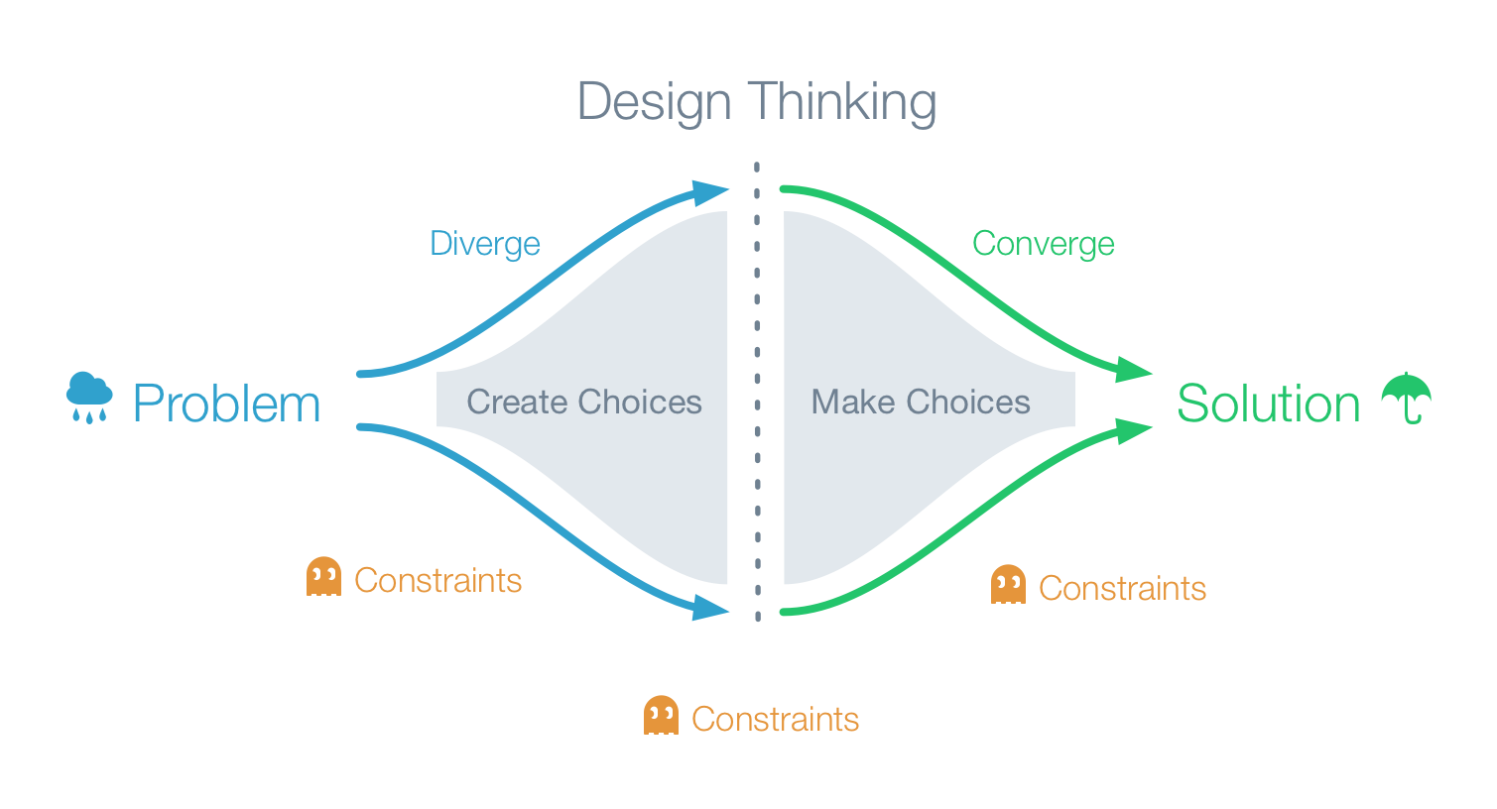
Creative Problem-Solving Processes

Slide 22

Behavioral flexibility
Understanding how and why people behave as they do increases your effectiveness in all relationships
Behavioral styles are the best predictor for how people prefer to communicate
Advantages of understanding:
Gain credibility and influence
Build commitment and confidence
Resolve complaints and prevent conflict
Get effective results working with difficult customers
Notes:
Duration 5 minutes
Say
It is important that we are able to flex our own personal style when dealing with our customers in order to build greater levels of rapport and stronger relationships as we move to become a trusted advisor.
Being aware of the styles and the differences of those styles can provide you with a good indicator of how people prefer to communicate.
The advantages of better understanding are
Gain credibility and influence
Gain commitment
Resolve and prevent conflict
Get effective results working with others
On the screen there are pairs of descriptors.
22

Slide 23
Behavioural Styles
From the pairs of descriptors below, tick the one which describes you the best. Make sure that one statement is ticked for every pair
A B
Dominant Easy going
Take Charge Go along
Assertive Hesitant
Challenging Accepting
Active Thoughtful
Confronting Supporting
Talkative Quiet
Bold Retiring
Intense Relaxed
Forceful Subtle
Total _______ ______
10
9
8
7
6
C D
Formal Informal
Disciplined Spontaneous
Self-controlled Responsive
Methodical Impulsive
Distant Close
Thinking Feeling
Task-oriented People-oriented
Reserved Outgoing
Matter of fact Dramatic
Cool Warm
Total _______ _______
0 1 2 3 4 5 6 7 8 9 10
4
3
2
1
Transpose total for Column B onto the horizontal line
Transpose total for Column C onto the vertical line
Notes:
Duration 10 minutes
Exercise
Look down the list and choose the descriptor in either A or B for each number that best describes you at work.
Repeat this process for C or D. It is important that you stress the fact that they must be in a “work” environment when they complete the descriptors.
Make a total of how many you have chosen for A,B,C and D (these should add up to 20).
Take the total for A and put a mark on the corresponding number on the horizontal axis.
Take the total for column C and put a mark on the corresponding number of the vertical access.
Say
It is important to understand, there is no right or wrong place on the axis – but this is an indicator of preferred behavioral styles.
Action
Use masking tape to make a X on the floor
Ask the participants to stand where they are and place the result on the grid.
This will allow you to map the whole group onto it, this will give an idea as to who sits were and therefore who to focus on when running though each behavioral style.
Say
We will need to run through and describe the characteristics of the axis,
Those that are to the right on the horizontal axis are more prone to making faster decisions, based on less data and are prepared to take more risks or riskier decisions, quite often they will make decisions based on experience or gut feel.
Those that are to the left of the horizontal axis are more prone to making slower and hence more considered decisions, which means they need more time and more data, the more left they are the more extreme this requirement becomes.
The C scores map to the vertical axis, so if someone scores 4 or below they are very much orientated towards people, so relationships and feelings are important part of their behavioral style.
If the C score is 6 or above then they are very much orientated towards tasks, so getting tasks complete, fixing problems and getting things done are an important part of their behavioral style.

Slide 24
Behavioural Styles
Task Focused
Higher Risk
Faster Decisions
Lower Risk
Slower Decisions
People Focused
Notes:
Time on slide 10 minutes
Highlight
Organise participants into colour profile. Go over each style in turn
When covering each style direct the material to participants that are sitting in that color or flip chart which ever you have used.
Ask which colour makes the best customer oriented people and listen to the replies.
The fact is that any colour makes a good sales person the key is the ability to spot the other person’s colour and adapt to them.

Slide 25
Behavioural Styles
Task Focused
Controller
(also Dominant or Driver)
Analyst
(also analytical or Conscientious)
Higher Risk
Faster Decisions
Lower Risk
Slower Decisions
Enthusiast
(Also Expressive or Influencer)
Facilitator
(Also Amiable or Steady)
People Focused
Notes:
Time on slide 10 minutes
Highlight
Organise participants into colour profile. Go over each style in turn
When covering each style direct the material to participants that are sitting in that color or flip chart which ever you have used.
Ask which colour makes the best customer oriented people and listen to the replies.
The fact is that any colour makes a good sales person the key is the ability to spot the other person’s colour and adapt to them.

Slide 26
Behavioural Styles
Task Focused
Dominant or Auxillary =>
Te
Dominant or Auxillary =>
Ti
Higher Risk
Faster Decisions
Lower Risk
Slower Decisions
Dominant or Auxillary =>
Fe
Dominant or Auxillary => Fi
People Focused
Notes:
Time on slide 10 minutes
Highlight
Organise participants into colour profile. Go over each style in turn
When covering each style direct the material to participants that are sitting in that color or flip chart which ever you have used.
Ask which colour makes the best customer oriented people and listen to the replies.
The fact is that any colour makes a good sales person the key is the ability to spot the other person’s colour and adapt to them.

Slide 27
Behavioural Styles
Behavioral Style
Focus
Tendencies
Controller
Problems
More task-focused, higher risk, faster decisions
Analyst
Procedures
More task-focused, lower risk, slower decisions
Facilitator
Pace
More people-focused, lower risk, slower decisions
Enthusiast
People
More people-focused, higher risk, faster decisions
Notes:
Time on slide 10 minutes
Slides: behaviour styles – note blank out the final column – how to deal with, and have a reveal to show the answers
Interactive Exercise (with whole group)
For each of the 4 styles, blank out the final column on the slide (‘how to deal with’),
Ask the group to make suggestions on how to deal with each preference – this will get more involvement in the session and test their understanding
You can then reveal the answers and show how close they were/ fill in the gaps.
27

Slide 28
Behavioural Styles - Controller
Key Behavioral indicators
Key motivation drivers
Emotional Behaviours
How to deal with?
Ambitious
“win”
Anger
Stick to business
Forceful
Be brief and to the point – get in get out
Short fuse
Decisive
Be prepared and well organized
Strong-willed
“do it now”
Quick to fly off handle
Focus on results
Independent
Also quick to cool down
Just give facts and options for action
Goal oriented
Notes:
Time on slide 5 minutes
Run through the Red style
As an interactive exercise introduce the 4 key headings, these being Key behavioural indicators, key motivation drivers, Emotional behaviours and How to deal with.
Get the group to offer up words that they would use to describe a red person under Key behavioural indicators. Then show our words and get them to agree or disagree, if you have red people test the words against them and get them to agree or not.
Also get people to think of a customer that may be a red person.
Then repeat process of asking them what words they would use under each heading and then share our words
Comments that you might hear from a person who has a Controller/Red behavioral style:
“Let’s get on with this and get it done”
“What will this mean to my business”?
“Why would we work with you”?
“Why would we work with you”?

Slide 29
Behavioural Styles - Analyst
Key Behavioral indicators
Key motivation drivers
Emotional Behaviours
How to deal with?
Neat
“Accuracy”
Fear/worry around
Consequences about making a bad decision
Be prepared with facts
Dependent
Stick to business
Keep emotions to a minimum
Conservative
Accurate and realistic
Careful
“Do it right”
Allow time for analysis
Perfectionist
Do not demand fast decisions
Compliant
Build integrity look at both sides of an issue
Notes:
Time on slide 5 minutes
Get the Green people to offer their results by each heading and then share our results and again get them to agree or disagree, also do they have any customers like this.
Comments that you might hear from a person who has an analytical/gold behavioral style:
“How exactly will this work”
“What specific information do you need from me”?
“Can you give me specific examples of where you have done this before”?
“Let me have a detailed proposal of your solution by….”

Slide 30
Behavioural Styles - Facilitator
Key Behavioral indicators
Key motivation drivers
Emotional Behaviours
How to deal with?
Patient
“Service”
Non-emotion
Break ice with personal comment
Reliable
Reserved
Talk softly and non threateningly
Steady
“Loyalty”
Not happy with conflict
Hard to read
Relaxed
Give time to think
Predictable
Successful projects
Recognition
Never commits
Do not demand fast decisions
Modest
Takes time
Thinking
Keep emotion levels low
Considerate
Contemplator
Weave work and personal items
Notes:
Time on slide 5 minutes
Get the blue people to offer their results by each heading and then share our results and again get them to agree or disagree, also do they have any customers like this.
Comments that you might hear from a person who has a facilitator/blue behavioral style:
“How will his help my people”
“Don’t rush me, let me reflect on your proposal”
“Can I speak to some of your other customers please?

Slide 31
Behavioural Styles - Enthusiast
Key Behavioral indicators
Key motivation drivers
Emotional Behaviours
How to deal with?
Confident
Valued, trusted
Optimism
“personal chat” – allow for this
Enthusiastic
Relationships key
Enthusiasm
Relevant
Focus on people
Demonstrative
Make a difference to influence a position decision
Talkative – empathy with people
Engage, understand specific individual needs
Expressive
Make them feel special
Likes attention
Decisive
Put requests and actions in writing
Notes:
Time on slide 5 minutes
Get the yellow people to offer their results by each heading and then share our results and again get them to agree or disagree, also do they have any customers like this.
Comments that you might hear from a person who has an enthusiast/green behavioral style:
“How could this benefit me and my team”?
“Give me some high level ideas”
“Be creative, think outside of the box with you solutions”
“We are so excited about this project”

Slide 32

Exercise: Spotting and dealing with Behavioural Styles
Take a Behavioural style that is opposite to you and answer following
How would you spot their style?
How would you deal with them?
How would you communicate with them?
Duration: 10 mins
Notes:
10 minutes total
Get delegates into pairs, and ask them to think about growers/customers they know. Think about their behavioral styles:
How would you spot their style?
How would you deal with them?
How would you communicate with them?
After 10 minutes, ask them to feed back to the group

Slide 33
Stop, Start, Continue….
What did we learn in this exercise?
What will we now stop doing?
What will we now start doing?
What will we continue to do that has served us well in the past?
Notes:
5mins
SAY: A useful reflection after seeing and discussing some new learning points is to ask ourselves.
What will we now stop doing?
What will we now start doing?
What will we continue to do that has served us well in the past?

Slide 34
Giving and receiving feedback
Giving and receiving feedback video https://www.youtube.com/watch?v=fGWYyvPhsf8
Feedback allows us to know ourselves better (those blind spots that others see that we don’t)
Communication relies on feedback
It allows us to make or ask for necessary adjustments
Feedback is information, and should be treated constructively
Giving and receiving feedback requires authenticity, sensitivity and care
Notes:
Definition - Living organisms possess feedback control systems of great complexity. For example, when the hand reaches for an object, information about its position is continuously fed back to the brain, both by the eyes and by position-sensing nerves in the arm; the brain uses the position information to guide the hand to the object. Such feedback can be termed voluntary, since it is to some extent under conscious control. Automatic, involuntary feedback is constantly taking place as well, controlling processes such as respiration, circulation, digestion, and maintenance of body temperature.
Why give feedback?
Whatever your position in an organisation, the skill of giving and receiving effective feedback is a key component in getting the job done, maintaining healthy and open relationships, and ensuring people grow and develop. Feedback enhances and encourages effective behaviours & provides insight and impetus to change those that are less productive.
What are the obstacles to giving feedback?
There are several obstacles to giving feedback, people will typically say : It’s not part of my job, It’s not in the culture; I don’t have time; Who am I to judge another?; I don’t want to hurt them
POST-OFFICE WORKER SCENARIO

Slide 35
Tip 1: Empathy
Do teams include empathetic individuals. These are team members who can listen to one other, understand, and reflect on others' thoughts and ideas. This is particularly important when someone brings up a concern or issue. According to Wageman et al. (2008), “on outstanding teams, nearly three-fourths of the members were identified as being able to consistently understand the content and meaning of others’ expressed concerns. On mediocre and poor teams, however, fewer than half demonstrated such empathy.”
A common misconception is that empathy simply means being nice. However, some of the most effective and empathetic teams can have more disagreements and conflicts than others. The difference here is that a team of empathetic individuals actively listen to one another to solve problems and make decisions

Slide 36
Tip 2: Integrity
Team members with integrity. This means that people will do what they have agreed to do, maintain confidentiality, communicate clearly and honestly, and do right by the team and stakeholders.
Members with integrity hold the team accountable for making decisions that do not align with the overall values and vision of the company (class/school) or task at hand.
As a leader, you want your team “to put hard questions and strong disagreements on the table and work them through to a conclusion that benefits the enterprise and its stakeholders” (Wageman et al., 2008).

Slide 37
Group Tasks for next class:
Update group ‘coat of arms’ group in M/Google doc (ready to make 2’ presentation to class next week)
Read from Moodle:
Gallup state-of-the-global-workplace-2023 report (see your country)
Read The importance of contracting and agreements
Link to the book “The Wisdom of Teams: Creating the High-Performance Organization”
Give feedback to each other in the Learning Group
Share in your learning group Google Doc in Moodle the Start Stop and Continue reflections
Gather more information about your shared problem and root cause. Which organizations have a stake in this problem?
Group of representatives send Andrew their preferred date for the first team coaching session by end of today.
Midterm exam => 16th December

Slide 38
Team Task
Give feedback to each other about the Helium bar.
Remember feedback is to help the other to learn and develop

Slide 39
Learning Log

Slide 40
Appendix Other slides for next time

Slide 41
Mindfulness Activity
??

Slide 42
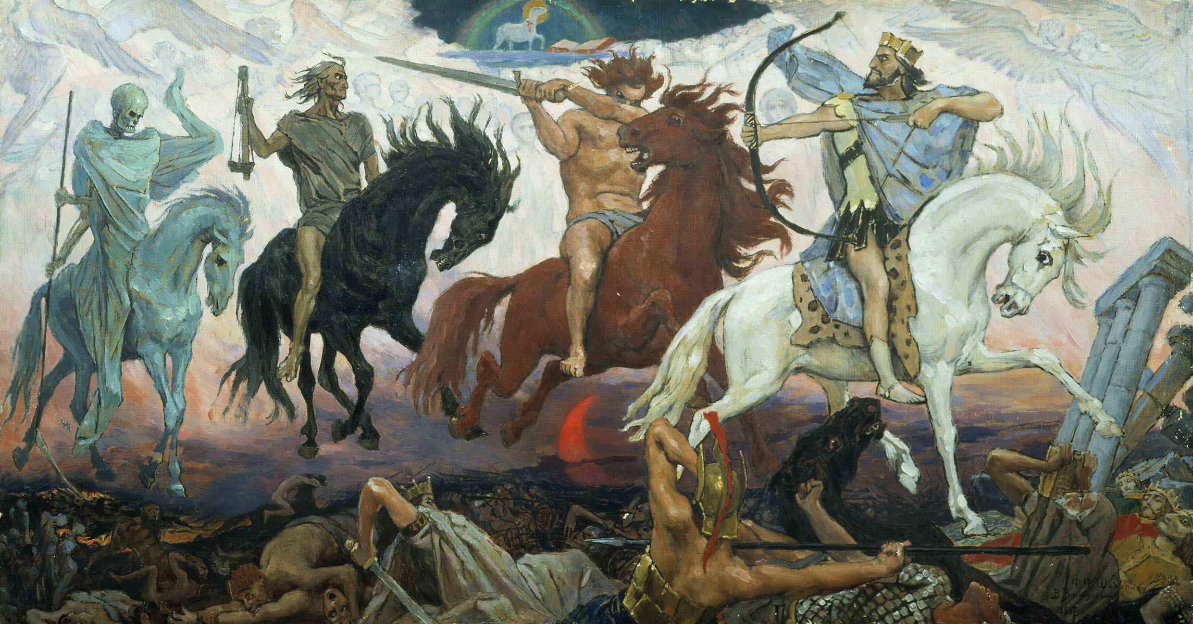
Four Horsemen of the Apocalypse

Slide 43
Four Horsemen of the Apocalypse
Criticism (judging based on merits or faults)
Contempt (expression of disrespect)
Defensiveness (playing victim)
and Stonewalling (avoiding conflict)
https://www.gottman.com/blog/the-four-horsemen-recognizing-criticism-contempt-defensiveness-and-stonewalling/

Slide 44
Four Horsemen Activity
In your group choose one of the 4 horseman behaviours
5’ to prepare a mini “play” to act out the behaviour
Other groups guess what it is?

Slide 45
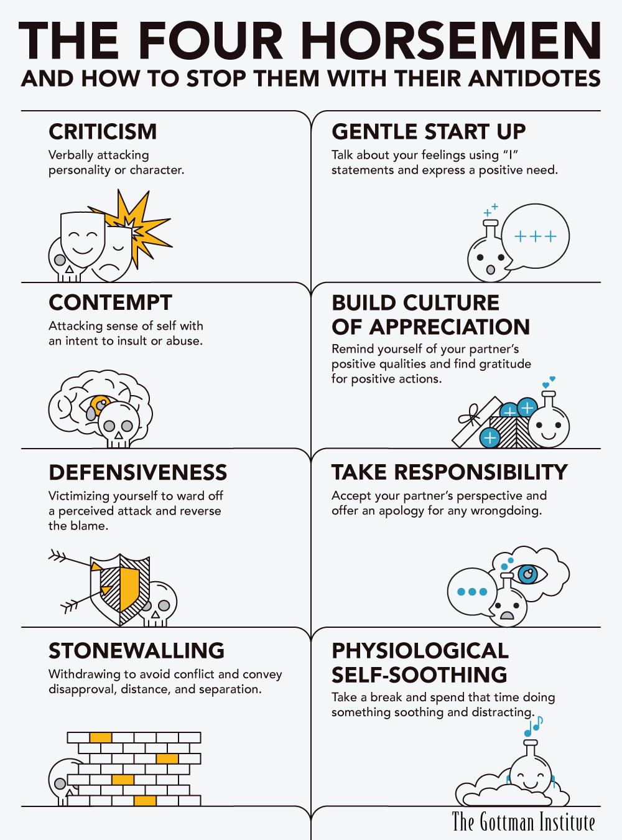

Slide 46
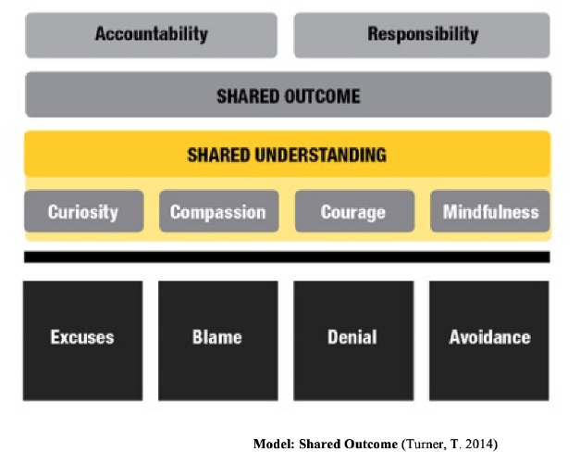
Group/Team Agreement Activity
In your group discuss what behaviours you want below and above the line. How will you create a shared understanding and outcome in the group/team? Who is responsible for their behaviours and who is accountable for the group becoming a team?

Slide 47
More material about today’s topics:
Power of Introverts https://www.ted.com/talks/susan_cain_the_power_of_introverts
How to Build Teamwork Through Heraldry https://www.inc.com/james-kerr/team-building-through-heraldry.html
Giving and receiving feedback by Simon Sinek https://www.youtube.com/watch?v=fGWYyvPhsf8
• TEDx Talks. (2014, May 5). Building a psychologically safe workplace | Amy Edmondson |TEDxHGSE [Video]. YouTube. https://www.youtube.com/watch?v=LhoLuui9gX8
• TEDx Talks. (2011, October 12). TEDxAtlanta - Teresa Amabile - The Progress Principle [Video]. YouTube. https://www.youtube.com/watch?v=XD6N8bsjOEE

